Slide 1
Cost Volume Pyramid Based Depth Inference for Multi-View Stereo Presenter: Zhuolun Zhou Tutor: HyunJun Jung
Notes:
CVPR 2020 oral paper

Slide 2
Outline: 1. Introduction 2. Related work 3. Method 4. Experiments 5. Personal comments

Slide 3
Outline: 1. Introduction 2. Related work 3. Method 4. Experiments 5. Personal comments

Slide 4
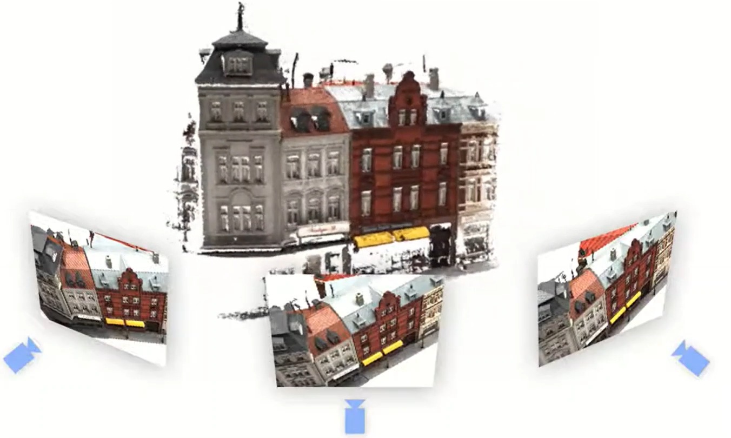
Introduction – Multi-View Stereo (MVS)
Source: [1] CVP-MVSNet
Notes:
- MVS aims to reconstruct the 3D model of a scene from a set of images captured by a camera from multiple viewpoints.
- fundamental problem in CV, has many applications, such as 3D reconstruction and VR

Slide 5
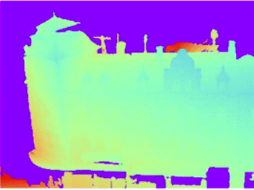
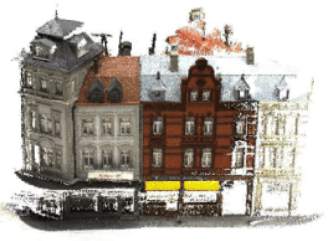
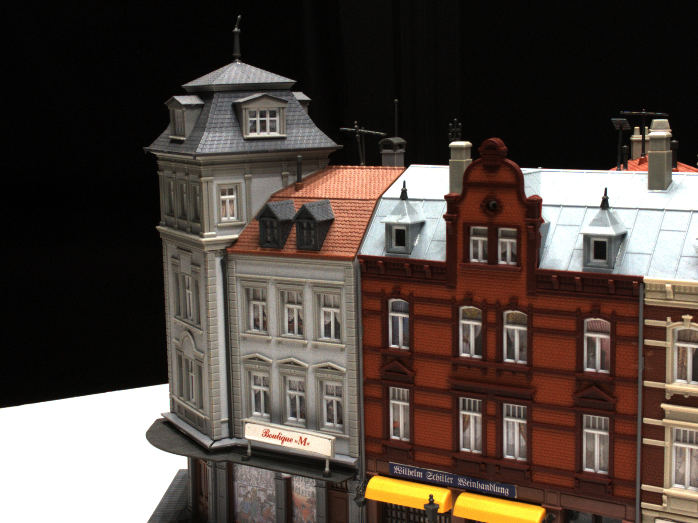
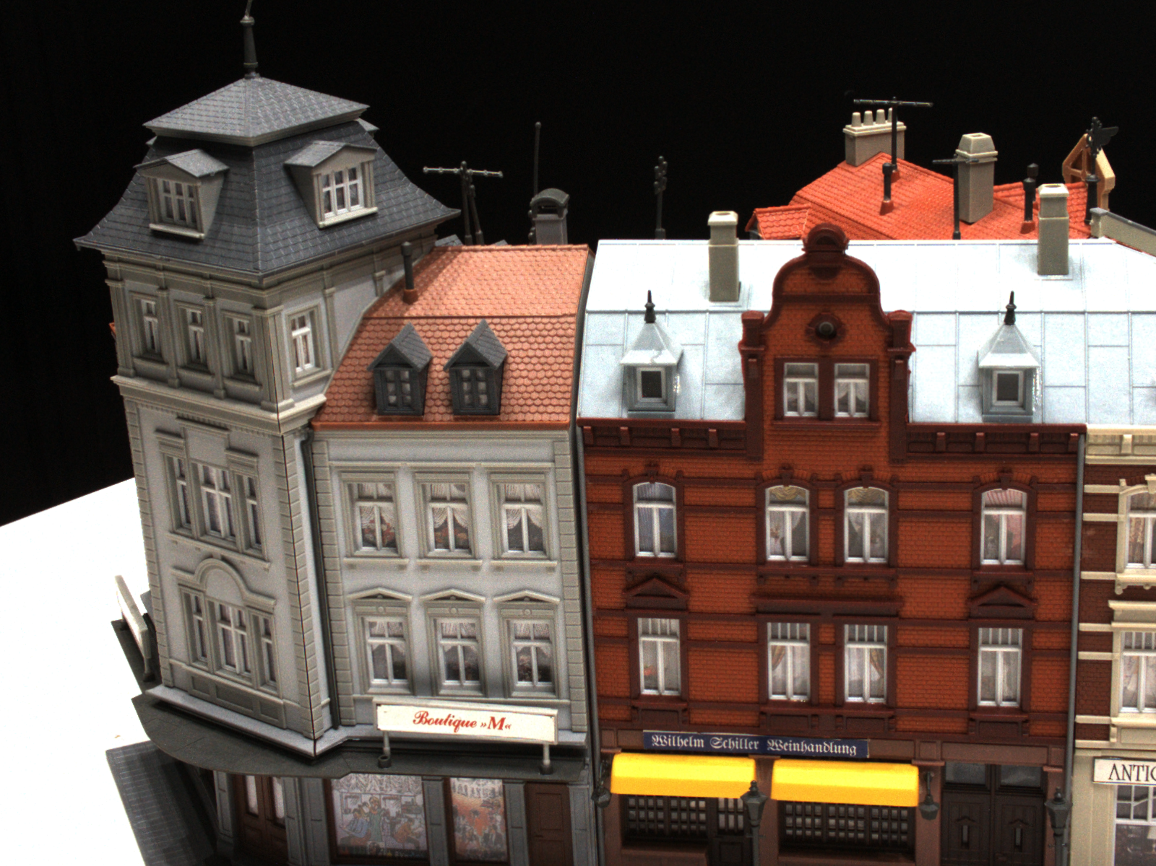
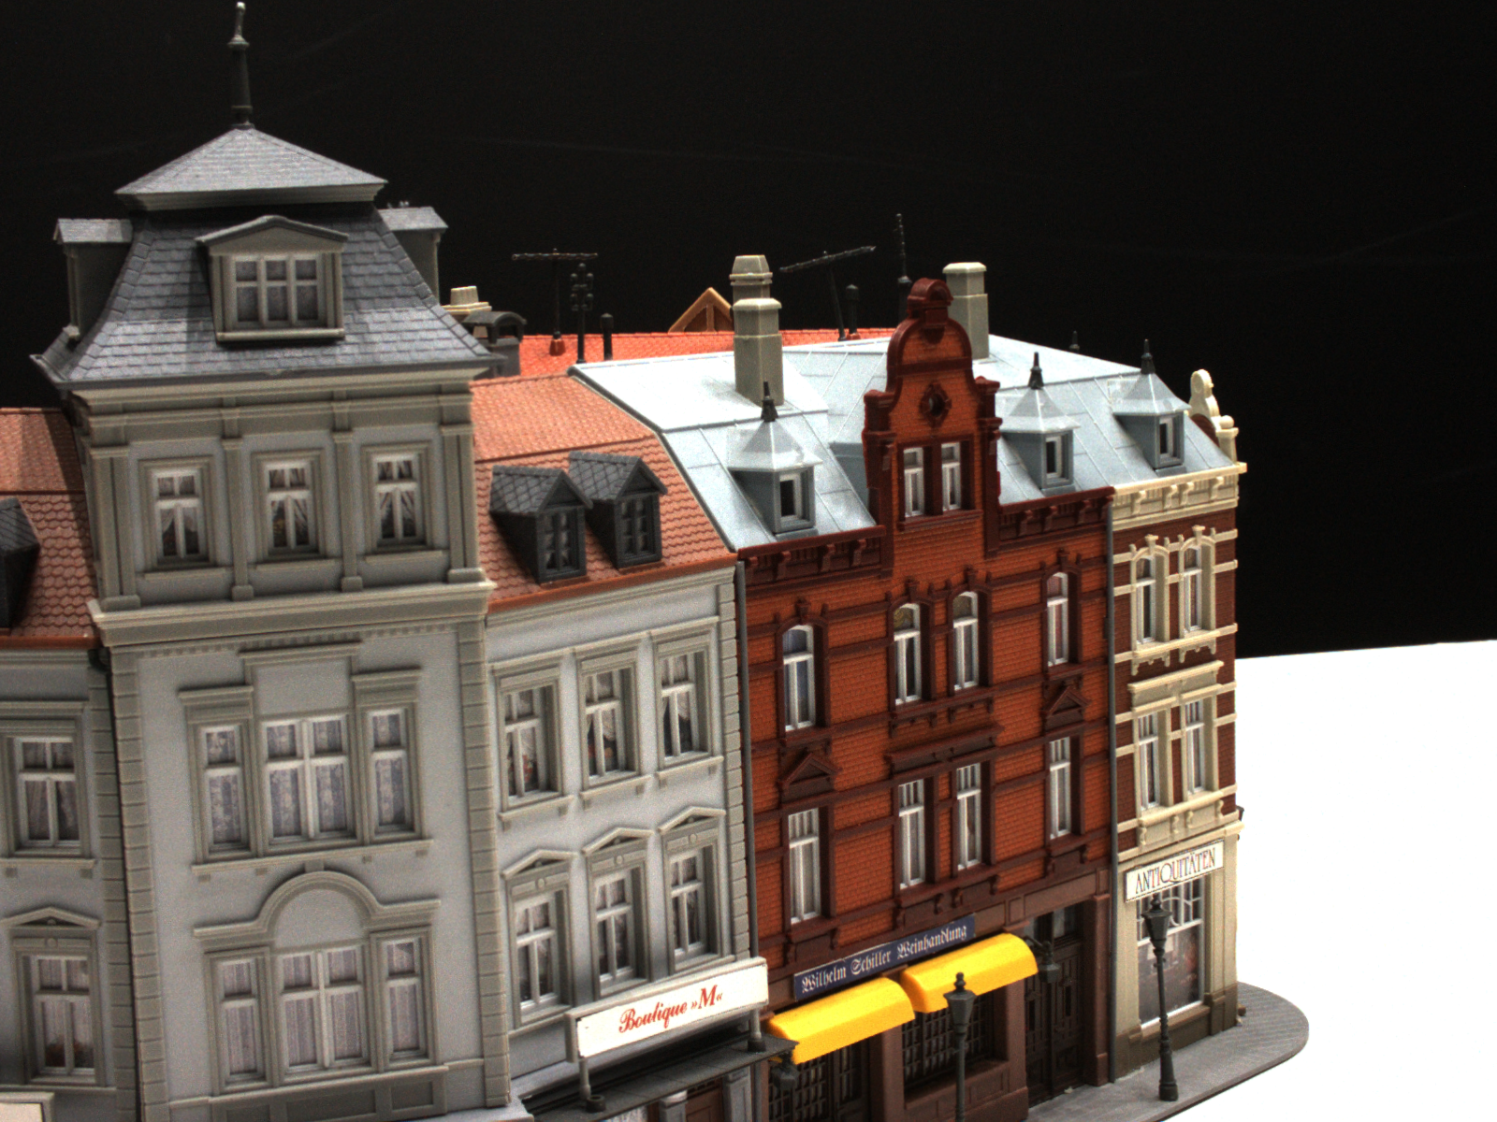
Introduction – Multi-View Stereo (MVS)
Depth Inference for MVS:
- Infer the depth map for a reference image using neighboring viewpoint source images
- Camera pose (rotation, translation) and intrinsics of each viewpoint are known (difference
with SLAM/Structure from Motion)
Depth Inference for MVS
…
src. image
ref. image
src. image
Notes:
This paper addresses MVS by depth inference, more specifically:
Given ref, and its neighboring src. images, depth inference for MVS aims to infer the depth map for the ref.. With the depth map, 3D model can be easily reconstructed.
Note that…

Slide 6
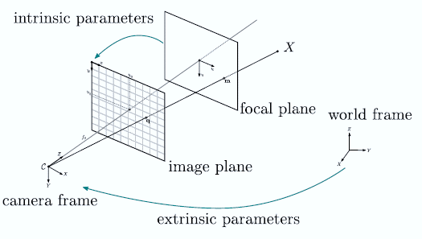
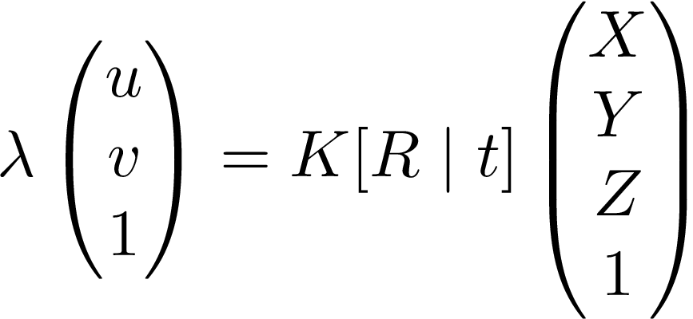
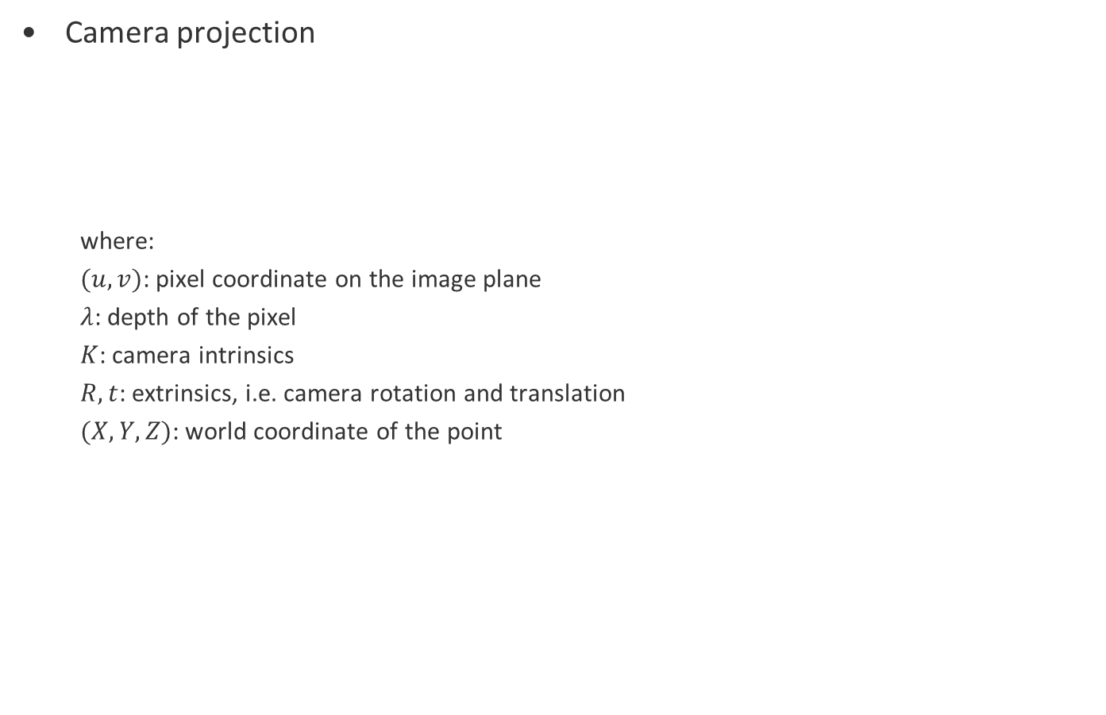
Introduction – Background knowledge
Camera projection
where:
$(u,v)$: pixel coordinate on the image plane
$λ$: depth of the pixel
$K$: camera intrinsics
$R, t$: extrinsics, i.e. camera rotation and translation
$(X,Y,Z)$: world coordinate of the point
Notes:
- Note that if we want to transfer a pixel on the image plane back to the world frame, given intrinsic and extrinsics, but no knowledge of the depth, the corresponding 3d point or the preimage of the pixel lies on a ray, we won’t know exactly where the point is.
- With the camera poses of each view, we can transfer btw. different views and easily reproject the pixel into other views.

Slide 7
Introduction – Background knowledge
Epipolar line
Since depth of a pixel is unknown, the reprojection of pixel of viewpoint 1 into viewpoint 2 lies on the epipolar line.
Photometric consistency
The same 3D point projected into different viewpoints should have similar color. Thus the depth could be estimated by minimizing the reprojection error.
epipolar line
error
depth
Notes:
For example, if we project this blue pixel in left view into right view. We don’t know the depth of the pixel, so we assume 4 depth hypo. We can use photometric consistency to pick out the depth candidates which is closest to the GT depth.
First, we project the pixel with the according depth hypo. into the right view.
Then, we choose the depth hypo. which results in the smallest reprojection error.
The reprojection error simply measures the difference between the original pixel color and the reprojected pixel color. We can sample more depth hypo. and get a more accurate depth estimation.
Most of the depth estimation methods rely on photometric consistency.

Slide 8
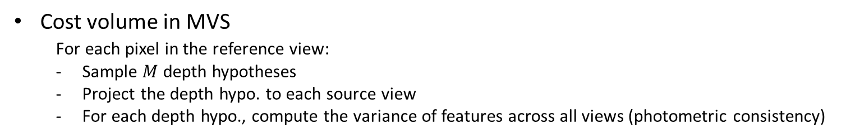


Introduction – Background knowledge
Cost volume in MVS
For each pixel in the reference view:
Sample $M$ depth hypotheses
Project the depth hypo. to each source view
For each depth hypo., compute the variance of features across all views (photometric consistency)
$$H$$
$$W$$
Src. View
Src. View
Ref. View
Notes:
previous slides of background knowledge are really basic knowledge in CV.
This part, cost volume is the specific background knowledge of this paper and you will only know it if you read some papers about MVS.
Suppose 1 ref. view and 2 src. view. Ref. view is the view that we are interested in and we want to estimate its depth map and src. view are the neighboring views of ref. view. The image dimension is H x W.

Slide 9
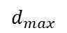
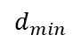
Introduction – Background knowledge
Cost volume in MVS
For each pixel in the reference view:
Sample $M$ depth hypotheses
Project the depth hypo. to each source view
For each depth hypo., compute the variance of features across all views (photometric consistency)
$$d_{max}$$
$$d_{min}$$
$$H$$
$$W$$
Src. View
Src. View
Ref. View
Notes:
For each pixel in the reference view, we sample M depth hypo. In this example, M is 4.

Slide 10
Introduction – Background knowledge
Cost volume in MVS
For each pixel in the reference view:
Sample $M$ depth hypotheses
Project the depth hypo. to each source view
For each depth hypo., compute the variance of features across all views (photometric consistency)
$$d_{max}$$
Variance
$$d_{min}$$
$$H$$
$$W$$
Src. View
Src. View
Ref. View
Notes:
- Then we project the depth hypo. into each src. view.
And we compute the variance of the features across all views. The result is one element of the cost volume.
- According to photometric consistency assumption, a small variance indicates a relatively accurate depth hypo.
- Variance is a cost function / metric for the depth hypothesis. That’s where the name cost volume comes from.

Slide 11
Introduction – Background knowledge
Cost volume in MVS
For each pixel in the reference view:
Sample $M$ depth hypotheses
Project the depth hypo. to each source view
For each depth hypo., compute the variance of features across all views (photometric consistency)
$$d_{max}$$
Variance
$$d_{min}$$
$$H$$
$$W$$
Src. View
Src. View
Ref. View

Slide 12
Introduction – Background knowledge
Cost volume in MVS
For each pixel in the reference view:
Sample $M$ depth hypotheses
Project the depth hypo. to each source view
For each depth hypo., compute the variance of features across all views (photometric consistency)
$$d_{max}$$
Variance
$$d_{min}$$
$$H$$
$$W$$
Src. View
Src. View
Ref. View

Slide 13
Introduction – Background knowledge
Cost volume in MVS
For each pixel in the reference view:
Sample $M$ depth hypotheses
Project the depth hypo. to each source view
For each depth hypo., compute the variance of features across all views (photometric consistency)
$$d_{max}$$
Variance
$$d_{min}$$
$$H$$
$$W$$
Src. View
Src. View
Ref. View
Source: Zhou
Notes:
Remember that, until now, this is only for a single pixel in the ref. view, and we repeat the process for each pixel.

Slide 14



Introduction – Background knowledge
Cost volume in MVS
For each pixel in the reference view:
Sample $M$ depth hypotheses
Project the depth hypo. to each source view
For each depth hypo., compute the variance of features across all views (photometric consistency)
$$d_{max}$$
$$d_{min}$$
$$H$$
$$M$$
$$H$$
$$W$$
$$W$$
cost volume
Src. View
Src. View
Ref. View
Source: Zhou
Notes:
- Each voxel of the cost volume is the matching cost of corresponding features projected form reference view and all source views.
- M channels.

Slide 15
Outline: 1. Introduction 2. Related work 3. Method 4. Experiments 5. Personal comments

Slide 16
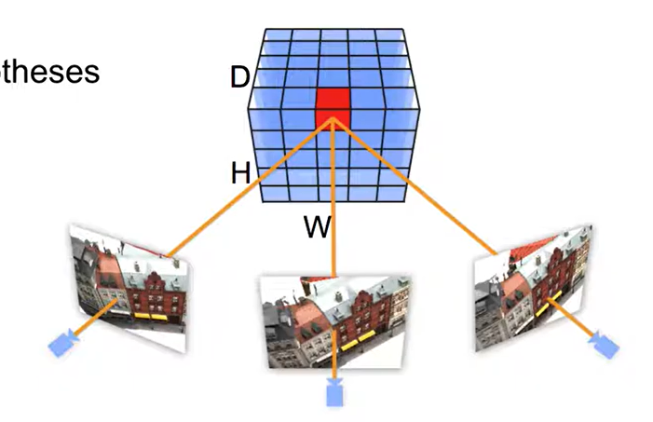
Related work
Cost volume based methods
Densely sampled depth hypotheses (MVSNet [2])
Memory consuming
M
Source: youtu.be/yx2JCviMRHg (10.06.2021)
Notes:
- learning based MVS methods.
For high accuracy depth estimation, MVSNet inferences on high resolution images and sample depth hypothesis densely across the whole depth range, which leads to large memory consumption.

Slide 17
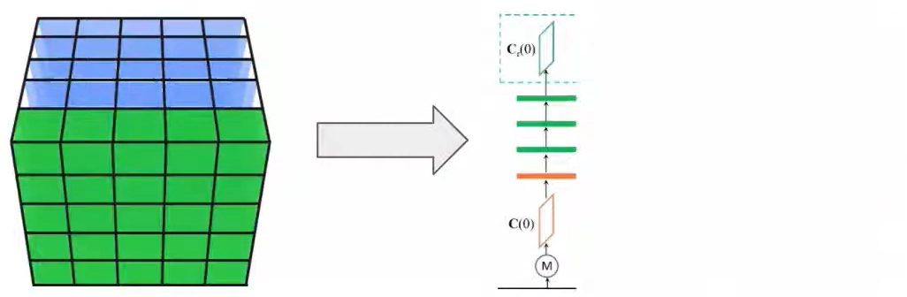
Related work
Cost volume based methods
Densely sampled depth hypotheses (MVSNet [2])
Memory consuming
Process the cost volume sequentially (R-MVSNet [3])
Time consuming
Source: youtu.be/yx2JCviMRHg (10.06.2021)
Notes:
R-MVSNet tries to address this problem by sequentially processing the cost volume using RNN. It reduces the memory usage but consumes much more time.

Slide 18
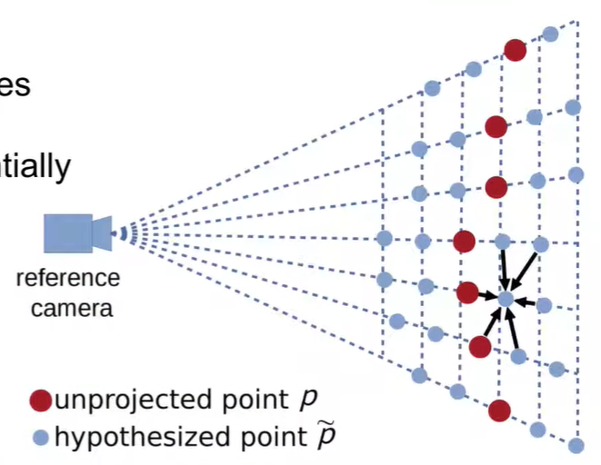
Related work
Cost volume based methods
Densely sampled depth hypotheses (MVSNet [2])
Memory consuming
Process the cost volume sequentially (R-MVSNet [3])
Time consuming
Point cloud based method
Convolution on point cloud (Point-MVSNet [4])
Not very time efficient
Source: [4] Point-MVSNet
Notes:
Alternatively, point-MVSNet tries to first estimate a coarse depth map and perform edge convolution directly on point cloud to refine the depth map. Despite its performance, convolution on point cloud is not efficient as well.
CVP MVSNet：fast, light-weight, and gives high accuracy depth estimation

Slide 19
Outline: 1. Introduction 2. Related work 3. Method 4. Experiments 5. Personal comments

Slide 20
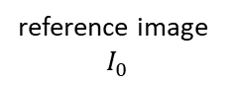
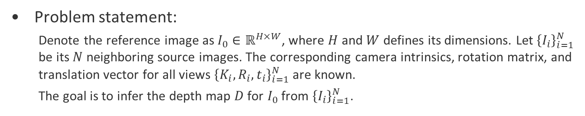
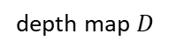
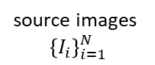
Method
Problem statement:
Denote the reference image as $I_{0}∈ℝ^{H×W}$, where $H$ and $W$ defines its dimensions. Let ${\left\{I_{i}\right\}}_{i=1}^{N}$ be its $N$ neighboring source images. The corresponding camera intrinsics, rotation matrix, and translation vector for all views ${\left\{K_{i}, R_{i}, t_{i}\right\}}_{i=1}^{N}$ are known.
The goal is to infer the depth map $D$ for $I_{0}$ from ${\left\{I_{i}\right\}}_{i=1}^{N}$.
depth map $D$
Depth Inference for MVS
…
reference image
$$I_{0}$$
source images
$${\left\{I_{i}\right\}}_{i=1}^{N}$$

Slide 21
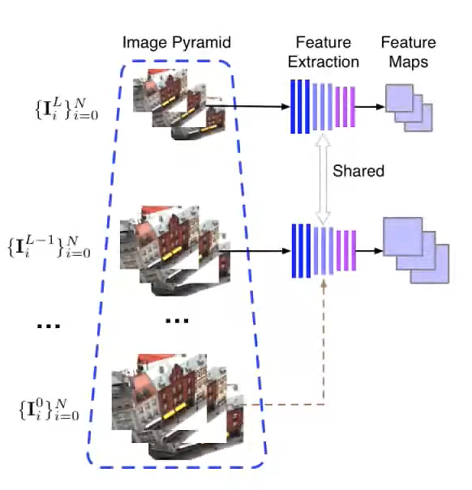
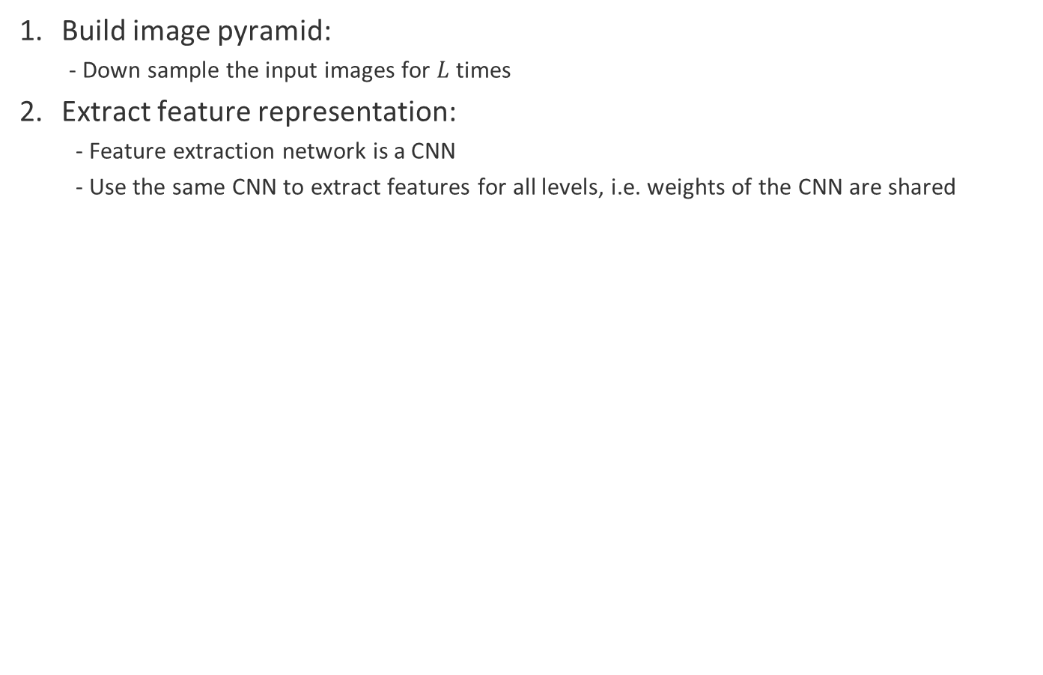
Method – Feature Pyramid
Build image pyramid:
- Down sample the input images for $L$ times
Extract feature representation:
- Feature extraction network is a CNN
- Use the same CNN to extract features for all levels, i.e. weights of the CNN are shared
Source: [1] CVP-MVSNet

Slide 22
Method – Cost Volume Pyramid
Cost volume
$$d_{max}$$
$$d_{min}$$
$$H$$
$$H$$
$$M$$
$$W$$
$$W$$
Src. feature map
Src. feature map
cost volume
Ref. feature map
Source: Zhou
Notes:
- In the intro. part, cost volume is built directly on images, in practice, cost volume is built on feature maps.
- didn’t mention how the depth hypo. are sampled. The novelty of this paper is mainly about iterative sampling of the depth hypo. By iterative sampling, a cost volume pyramid is built.

Slide 23
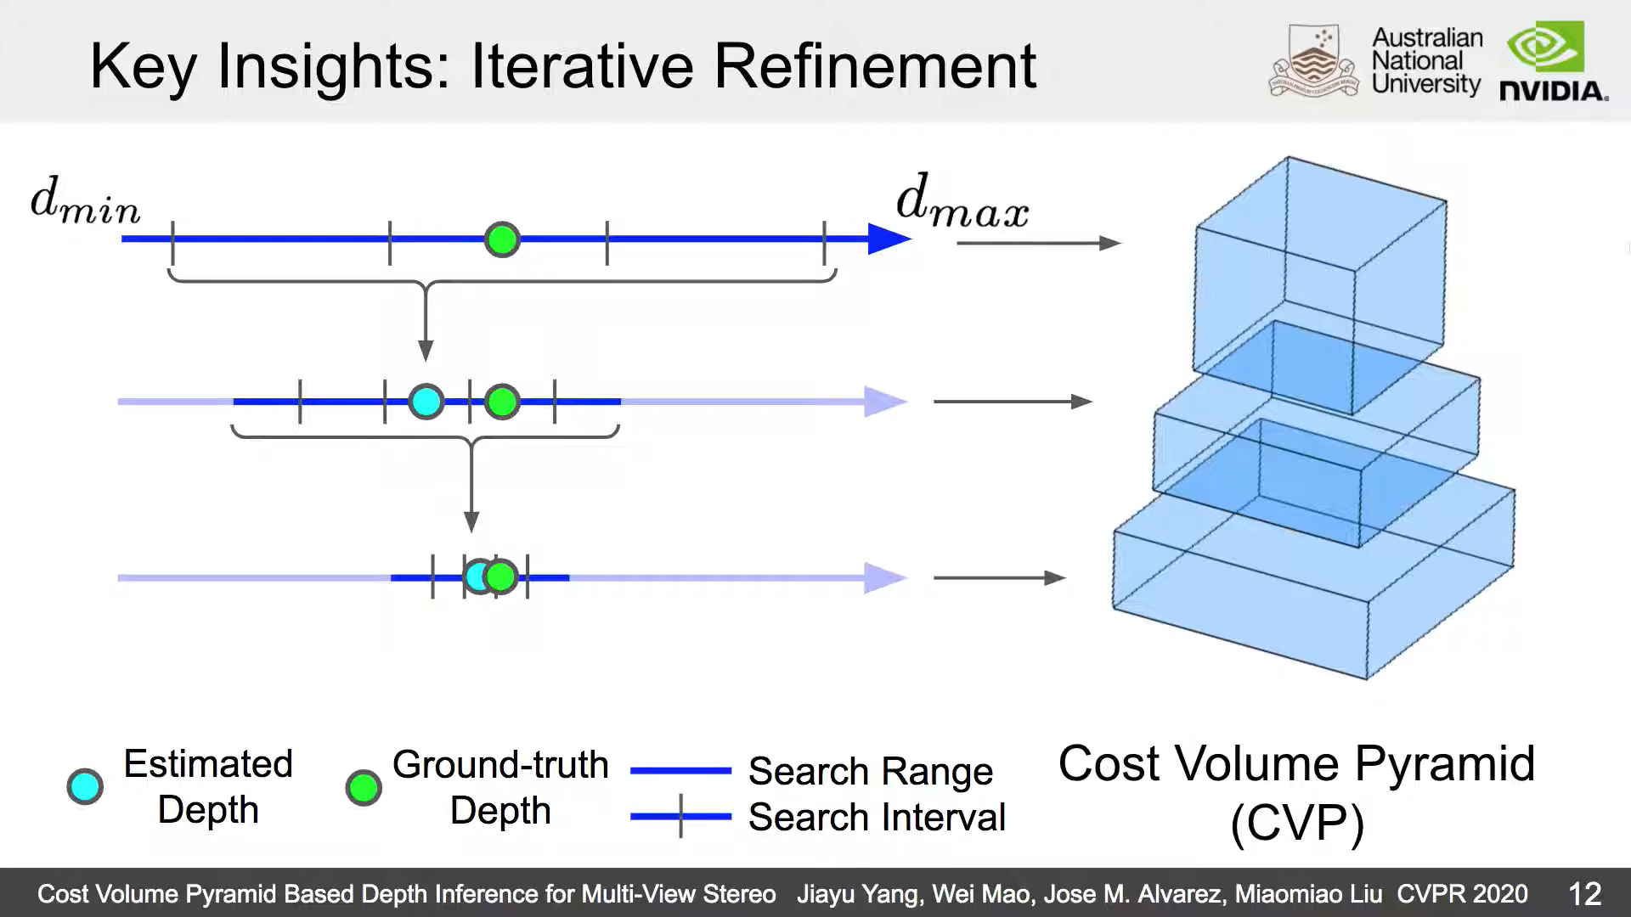
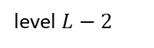
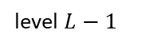
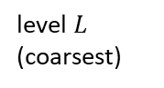
Method – Cost Volume Pyramid
Iterative refinement
level $L$ (coarsest)
level $L−1$
level $L−2$
…
…
Source: youtu.be/yx2JCviMRHg (10.06.2021)
Notes:
At coarsest level of feature pyramid, depth hypo. are uniformly sampled in the whole depth range.
Cost volume is then fed into a depth estimator network, which will be introduced in a minute, to predict the depth map at the coarsest level.
For each level afterwards, the depth search range will be centered around the previously estimated depth with a smaller searching interval. And thus producing more accurate depth map.
e.g, L-2
Building a cost volume in this way will consume less GPU memory and is also faster at run time.

Slide 24
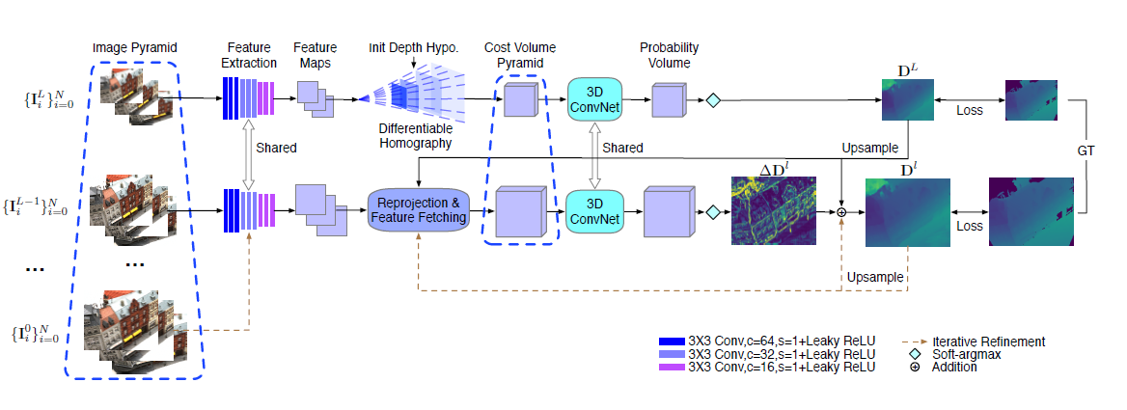
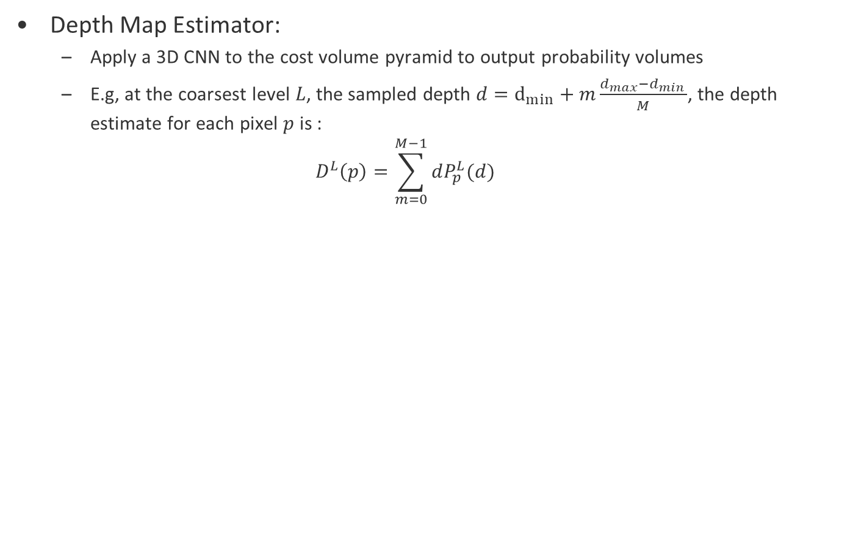
Method – Depth Map Estimator
Depth Map Estimator:
Apply a 3D CNN to the cost volume pyramid to output probability volumes
E.g, at the coarsest level $L$, the sampled depth $d=d_{min}+m\frac{d_{max}−d_{min }}{M}$, the depth estimate for each pixel $p$ is :
$$D^{L}\left(p\right)=\sum_{m=0}^{M−1}{dP_{p}^{L}(d)}$$
Source: [1] CVP-MVSNet
Notes:
Each channel of the probability volume stores the probability of the corresponding depth hypo.
- The depth map is simply a weighted sum of each channel of the probability volume. The weights are the depth values.

Slide 25
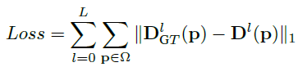
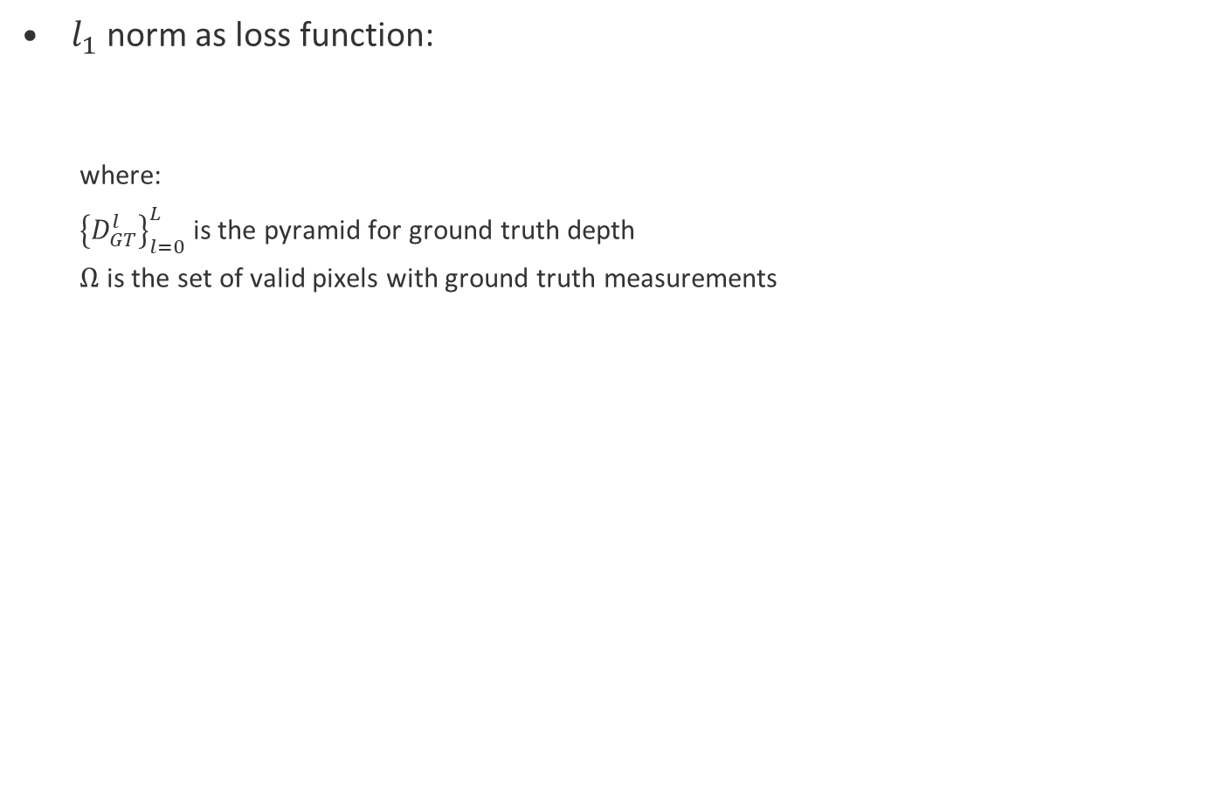
Method – Loss Function
$l_{1}$ norm as loss function:
where:
${\left\{D_{GT}^{l}\right\}}_{l=0}^{L}$ is the pyramid for ground truth depth
$Ω$ is the set of valid pixels with ground truth measurements
Notes:
Note that the GT depth is also downsampled at each level of pyramid to match the resolution.

Slide 26
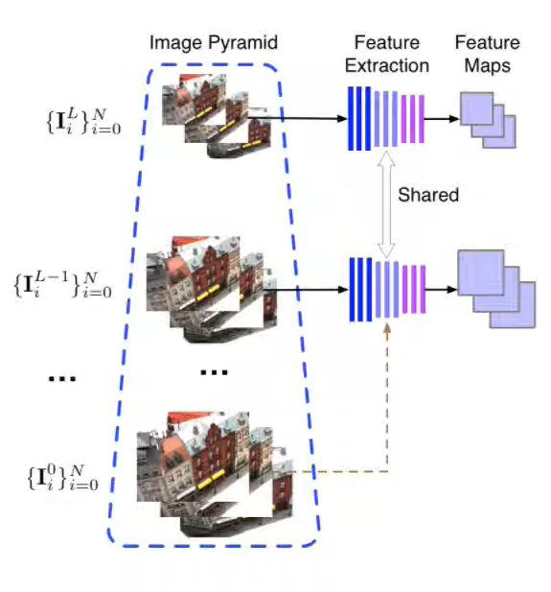
Method – Summary
Notes:
Given a set of input images, we build an image pyramid and use a shared weight feature extraction network to extract feature map for each level of the pyramid.

Slide 27
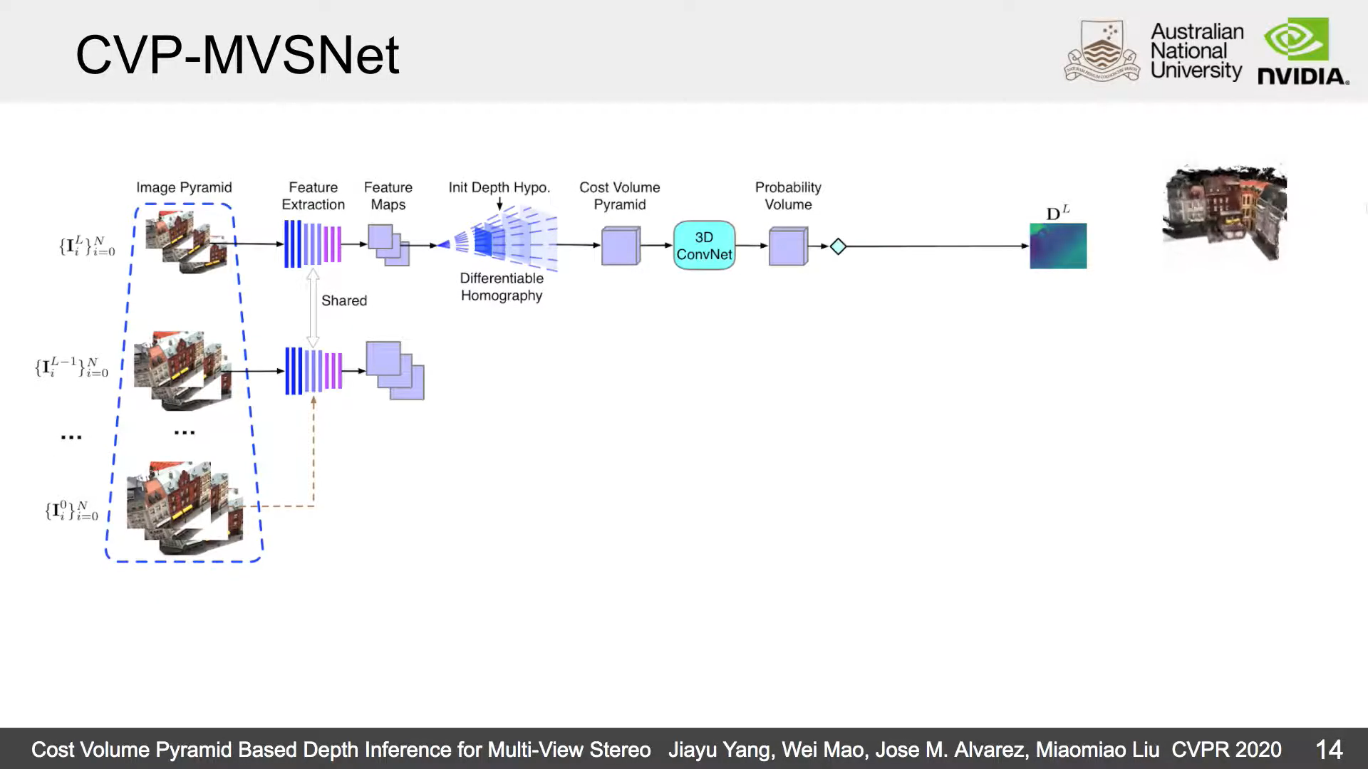
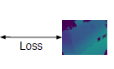
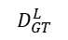
Method – Summary
$$D_{GT}^{L}$$
Notes:
a small cost volume is built to estimate a coarse depth map.

Slide 28
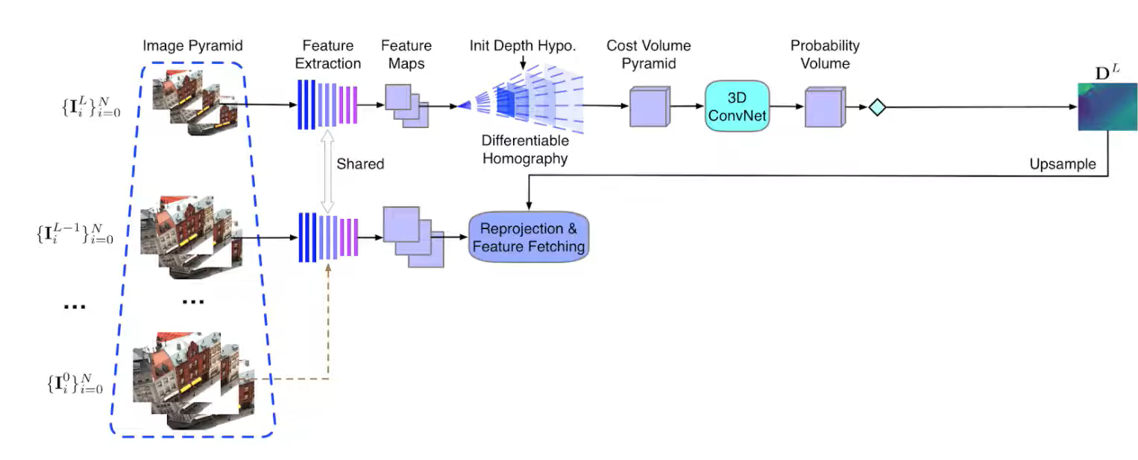
Method – Summary
$$D_{GT}^{L}$$
Notes:
the initial depth map is then upsampled to match higher resolution image. And the upsampled depth map from last level is used as the initial depth value in the current level.

Slide 29
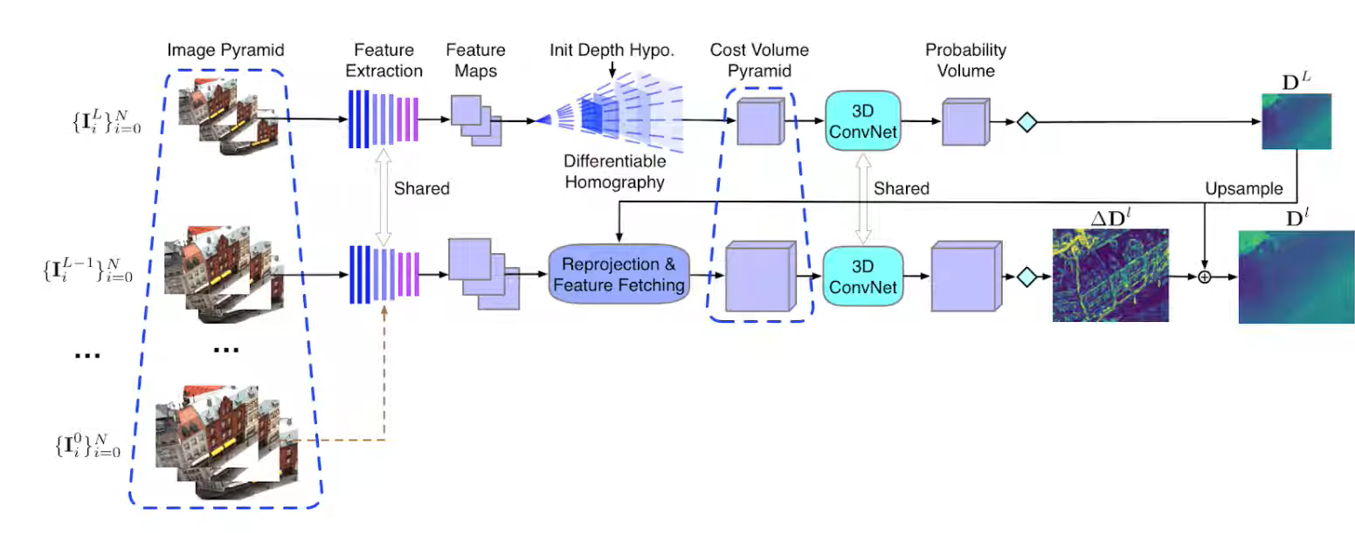
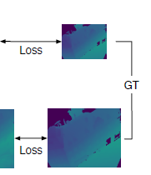
Method – Summary
Notes:
we build a partial cost volume to estimate the refined depth map

Slide 30
Method – Summary
Notes:
the refinement can be performed several times iteratively to generate high quality point cloud

Slide 31
Outline: 1. Introduction 2. Related work 3. Method 4. Experiments 5. Personal comments

Slide 32
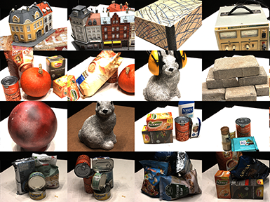
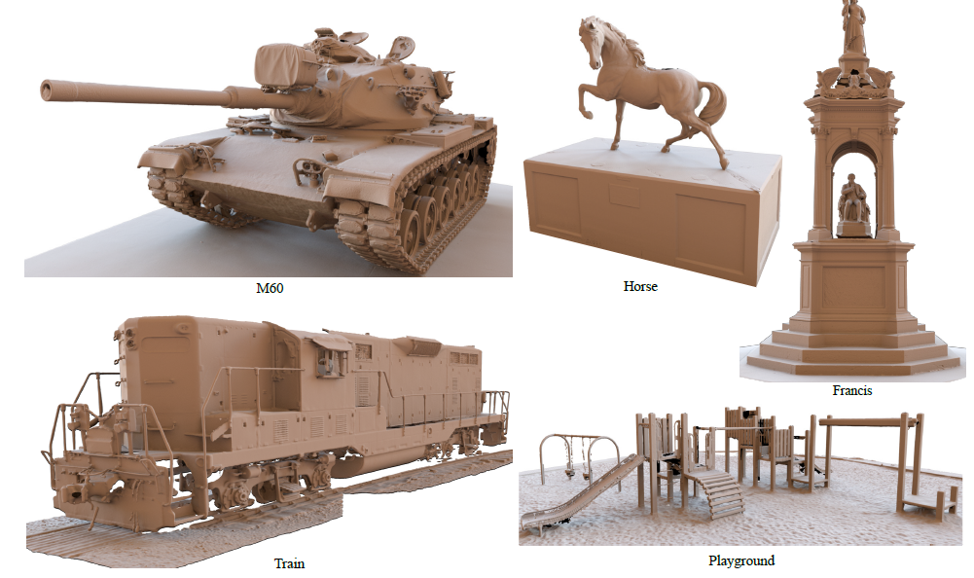
Experiments - Dataset
DTU Dataset [5]
- For train and test
- Table top objects in laboratory conditions
Tank and Temples [6]
- For test
- Indoor and outdoor scenes in realistic conditions

Slide 33
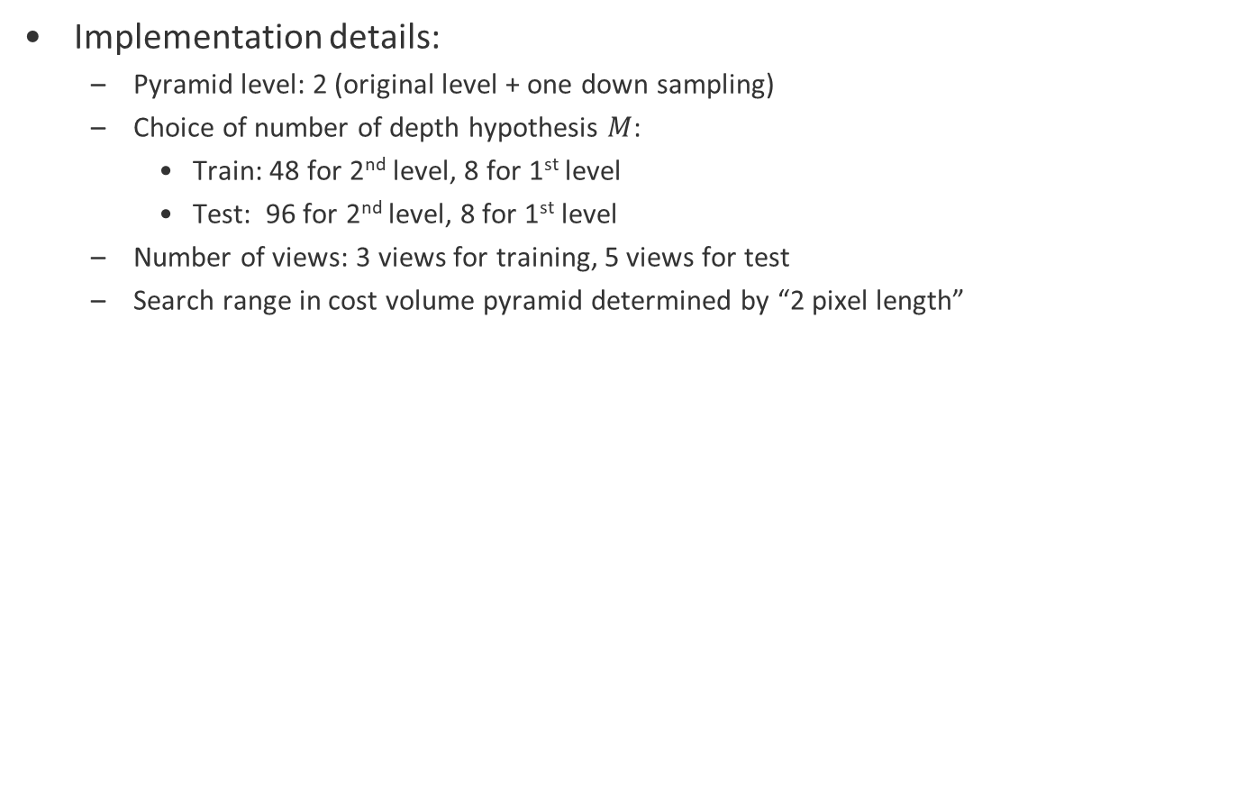
Experiments - Setting
Implementation details:
Pyramid level: 2 (original level + one down sampling)
Choice of number of depth hypothesis $M$:
Train: 48 for 2nd level, 8 for 1st level
Test: 96 for 2nd level, 8 for 1st level
Number of views: 3 views for training, 5 views for test
Search range in cost volume pyramid determined by “2 pixel length”
Notes:
There are some details behind the choice of M and this 2 pixel length, but it’s too technical and I won’t go into the details. But if you are interested, feel free to ask questions and I can explain.

Slide 34
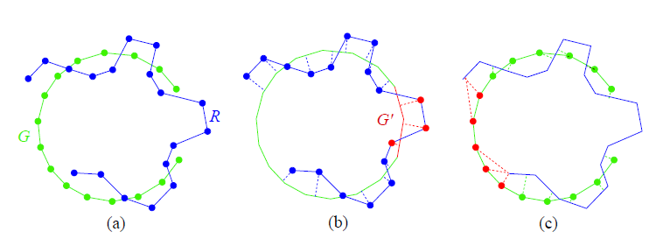
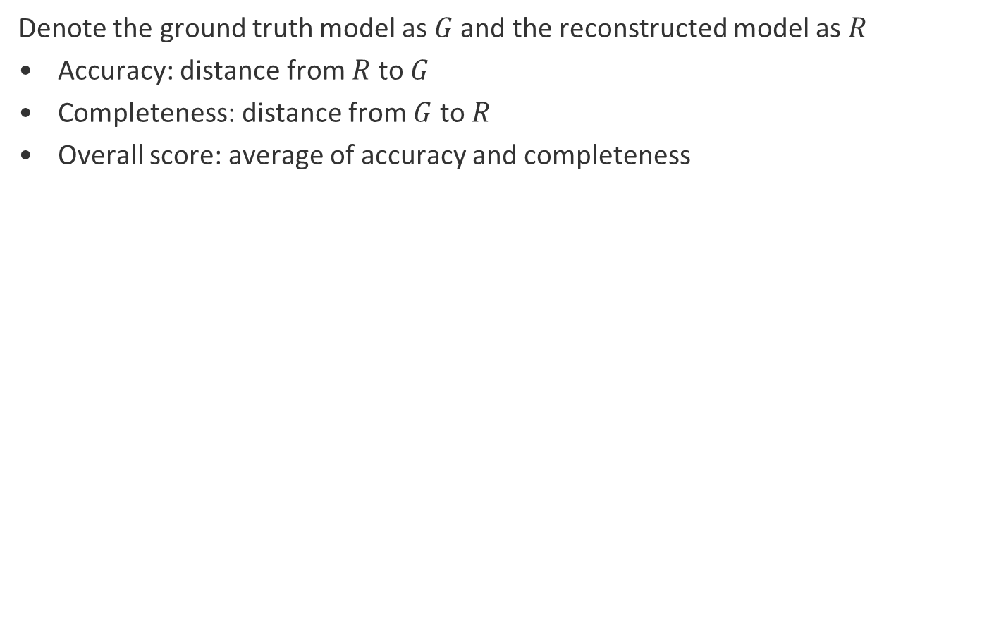
Experiments - Metrics
Denote the ground truth model as $G$ and the reconstructed model as $R$
Accuracy: distance from $R$ to $G$
Completeness: distance from $G$ to $R$
Overall score: average of accuracy and completeness
accuracy
completeness
Fig. Illustration of accuracy and completeness. From [7]
Notes:
The names are kind of self-explaining.
If only accuracy were reported, it would favor algorithms that only include estimated points of high certainty, e.g. high-textured surface parts.
On the other hand, if only completeness were reported it would favor algorithms that include everything, regardless of point quality.

Slide 35
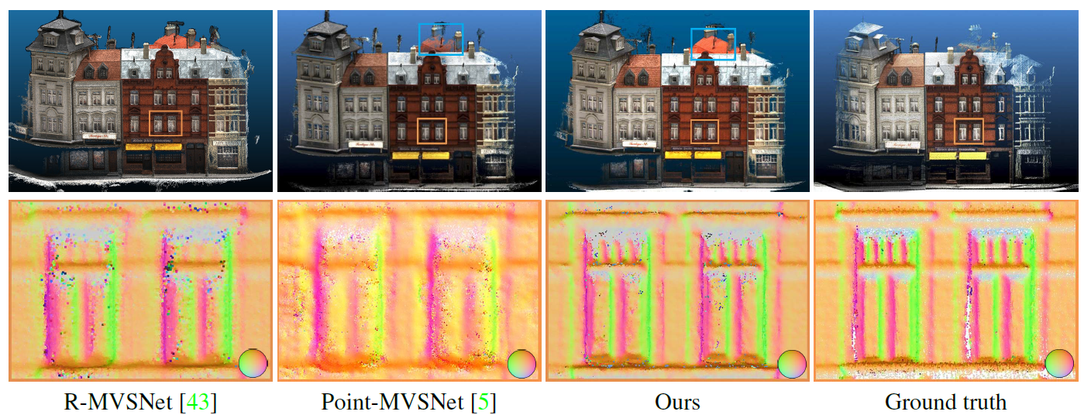
Experiments – Qualitative results
point
cloud
normal
map
[3]
[4]
Fig. Results on DTU test set. From [1]
Notes:
- The upper row shows the point clouds and the bottom row shows the normal map corresponding to the orange rectangle.
- As highlighted in the blue rectangle, the completeness of the proposed method is better than Point-MVSNet.
- The normal map (orange rectangle) further shows that the proposed method is smoother on surfaces while maintaining more high-frequency details.

Slide 36
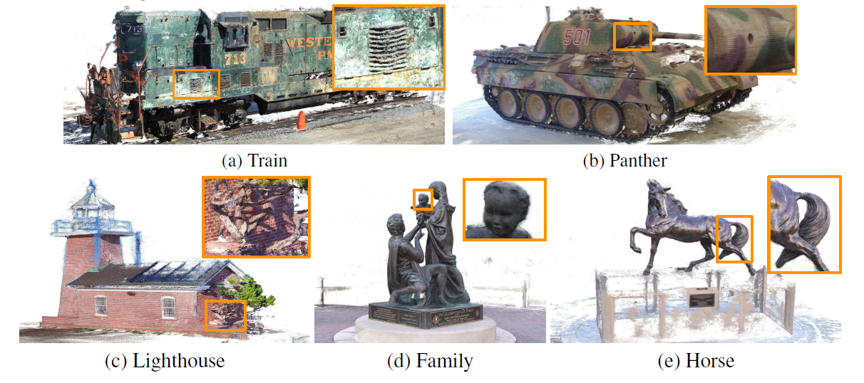
Experiments – Qualitative results
Fig. Point cloud reconstruction on Tanks and Temple dataset. Note that the model hasn’t trained/fine-tuned on this dataset. From [1]
Notes:
good generalization ability

Slide 37
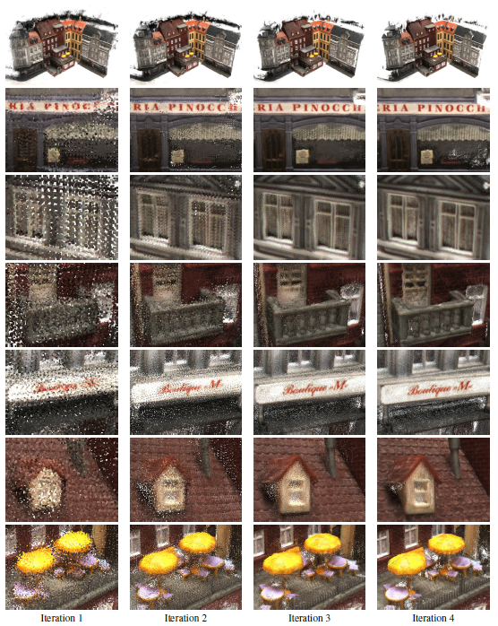
Experiments – Qualitative results
Fig. Intermediate point cloud results. Quality improved for every iteration of depth residual refinement. From [1]

Slide 38
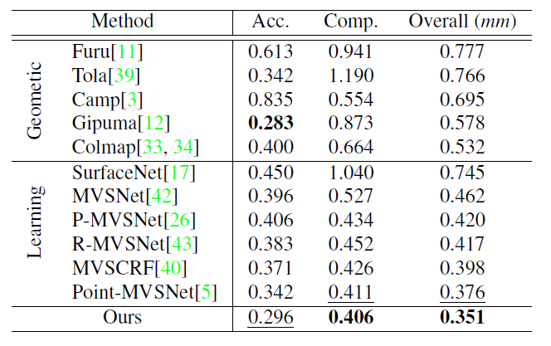
Experiments – Quantitative results
Tab. Quantitative results of reconstruction quality on
DTU dataset (lower is better). From [1]
Notes:
The proposed method
- outperforms all methods on Completeness and Overall reconstruction quality
- achieved second best on Accuracy.

Slide 39
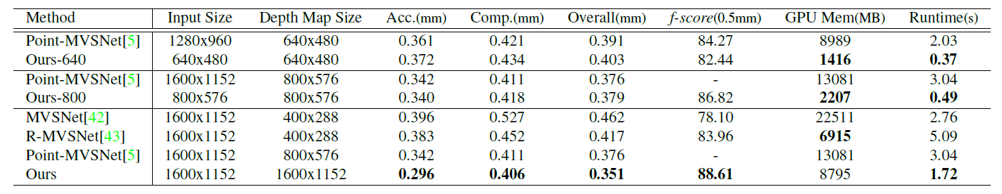
Experiments – Quantitative results
Tab. Comparison of reconstruction quality, GPU memory usage and runtime on DTU dataset for different input sizes. From [1]
Notes:
- For the same size of depth maps, the proposed method has a performance similar
with Point-MVSNet, and is 6 times faster and consumes 6 times smaller GPU memory.
- For the same size of input images, the proposed method achieves the best reconstruction with the shortest time and a reasonable GPU memory usage.

Slide 40
Outline: 1. Introduction 2. Related work 3. Method 4. Experiments 5. Personal comments

Slide 41
Personal comments
Building a pyramid structure in a coarse-to-fine manner is a common approach to increase speed and reduce memory requirement.
By building a cost volume pyramid, the proposed approach refines the previous work (MVS-Net[2]).
Combining old ideas (pyramid structure, cost volume) with careful implementation works.
Notes:
e.g. in optical flow, motion estimation and frame interpolation
Tbh, I think this paper does not has much novelty. But 3

Slide 42
References
[1] Yang, Jiayu, et al. "Cost volume pyramid based depth inference for multi-view stereo." Proceedings of the IEEE/CVF Conference on Computer Vision and Pattern Recognition. 2020.
[2] Yao, Yao, et al. "Mvsnet: Depth inference for unstructured multi-view stereo." Proceedings of the European Conference on Computer Vision (ECCV). 2018.
[3] Yao, Yao, et al. "Recurrent mvsnet for high-resolution multi-view stereo depth inference." Proceedings of the IEEE/CVF Conference on Computer Vision and Pattern Recognition. 2019.
[4] Chen, Rui, et al. "Point-based multi-view stereo network." Proceedings of the IEEE/CVF International Conference on Computer Vision. 2019.
[5] Jensen, Rasmus, et al. "Large scale multi-view stereopsis evaluation." Proceedings of the IEEE conference on computer vision and pattern recognition. 2014.
[6] Knapitsch, Arno, et al. "Tanks and temples: Benchmarking large-scale scene reconstruction." ACM Transactions on Graphics (ToG) 36.4 (2017): 1-13.
[7] Seitz, Steven M., et al. "A comparison and evaluation of multi-view stereo reconstruction algorithms." 2006 IEEE computer society conference on computer vision and pattern recognition (CVPR'06). Vol. 1. IEEE, 2006.

Slide 43
Questions?

Slide 44
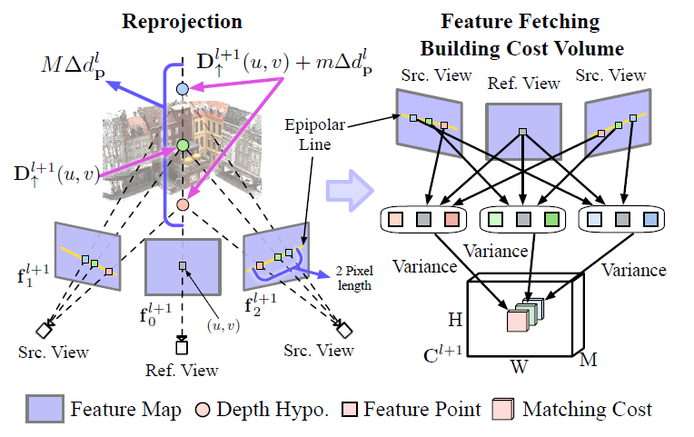
Back up – 2 pixel length
Depth search range
Depth hypo.
Initial depth estimation
Projected feature points

Slide 45
Back up – Cost Volume Pyramid
Depth search range
Depth hypo.
Initial depth estimation
cost volume
The correct depth for each pixel has the smallest feature variance, which corresponds to photometric consistency constraint
Notes:
inverse warping

Slide 46
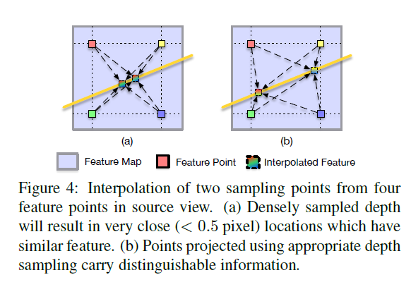
Back up – Determination of M

Slide 47
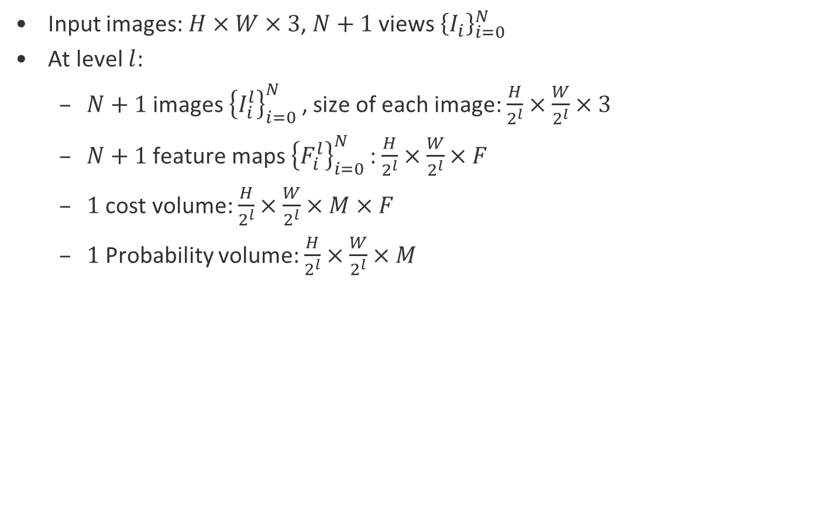
Back up - Dimensions
Input images: $H×W×3$, $N+1$ views ${\left\{I_{i}\right\}}_{i=0}^{N}$
At level $l$:
$N+1$ images ${\left\{I_{i}^{l}\right\}}_{i=0}^{N}$, size of each image: $\frac{H}{2^{l}}×\frac{W}{2^{l}}×3$
$N+1$ feature maps ${\left\{F_{i}^{l}\right\}}_{i=0}^{N}$: $\frac{H}{2^{l}}×\frac{W}{2^{l}}×F$
$1$ cost volume: $\frac{H}{2^{l}}×\frac{W}{2^{l}}×M×F$
$1$ Probability volume: $\frac{H}{2^{l}}×\frac{W}{2^{l}}×M$

Slide 48
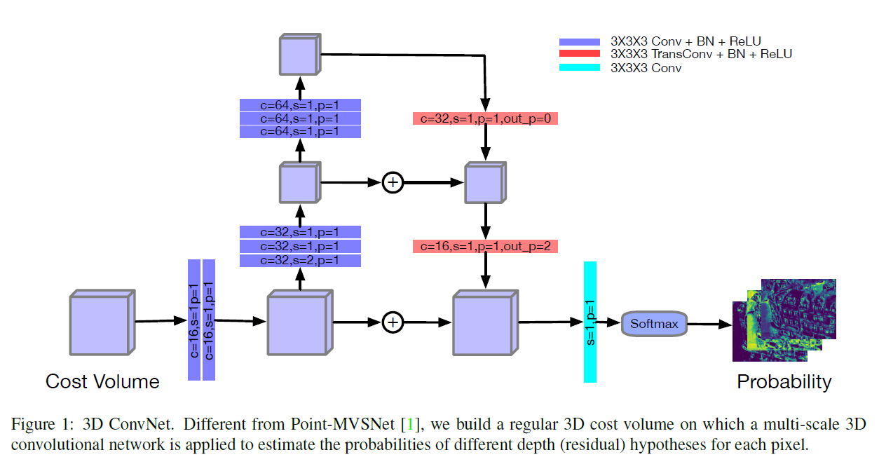
Back up – Architecture of depth estimator NN

